Slide 1


Slide 2
Online Giving Overview
Demo
Marketing Online Giving
Online Giving Statistics

Slide 3
Online Giving Overview
What’s the difference?
  Auto Clearing House (ACH)
  Electronic Fund Transfer (EFT)
  Online Giving

Slide 4

Online Giving Overview
Web based interface
Offertory or event payments
Donor controlled account
Flexible giving options
  Recurring or one time
  Campaigns and special collections
  ACH or Credit Card
Administrator reporting privileges
Contribution data exports
Low lead time for deposits

Slide 5

Online Giving Overview
Encrypted website
  128 bit SSL
  No data stored here
  Sage secure vault
Merchant of record
Funds are not held by payment processor
Parish will enter into PCI compliant status
Parish staff has zero exposure to card data or bank account information

Slide 6
Online Giving Overview
Demo
Marketing Online Giving
Online Giving Statistics

Slide 7
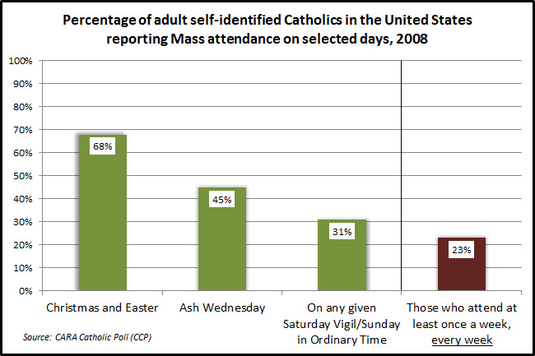
Church attendance alone severely limits total collections.

Slide 8
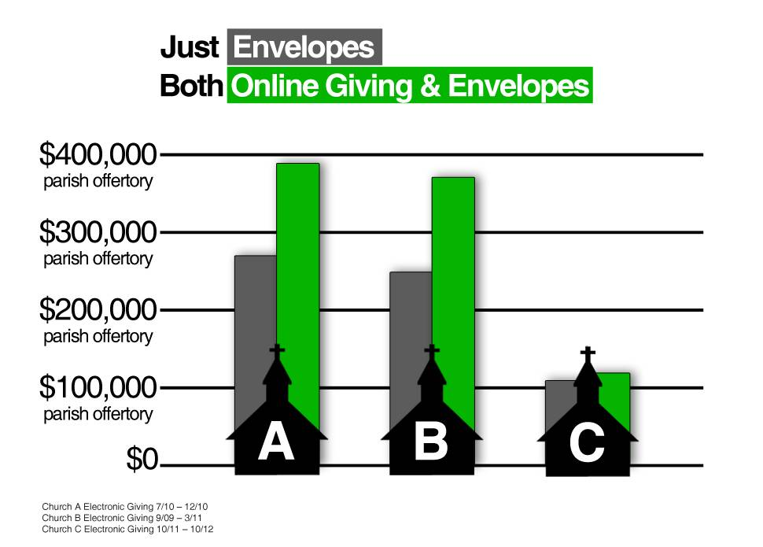
Model Parish OLG Results

Slide 9
Flexibility Leads to Larger Donations
Based on analysis of over 560,000 transactions processed between May 2009 and April 2013.

Slide 10
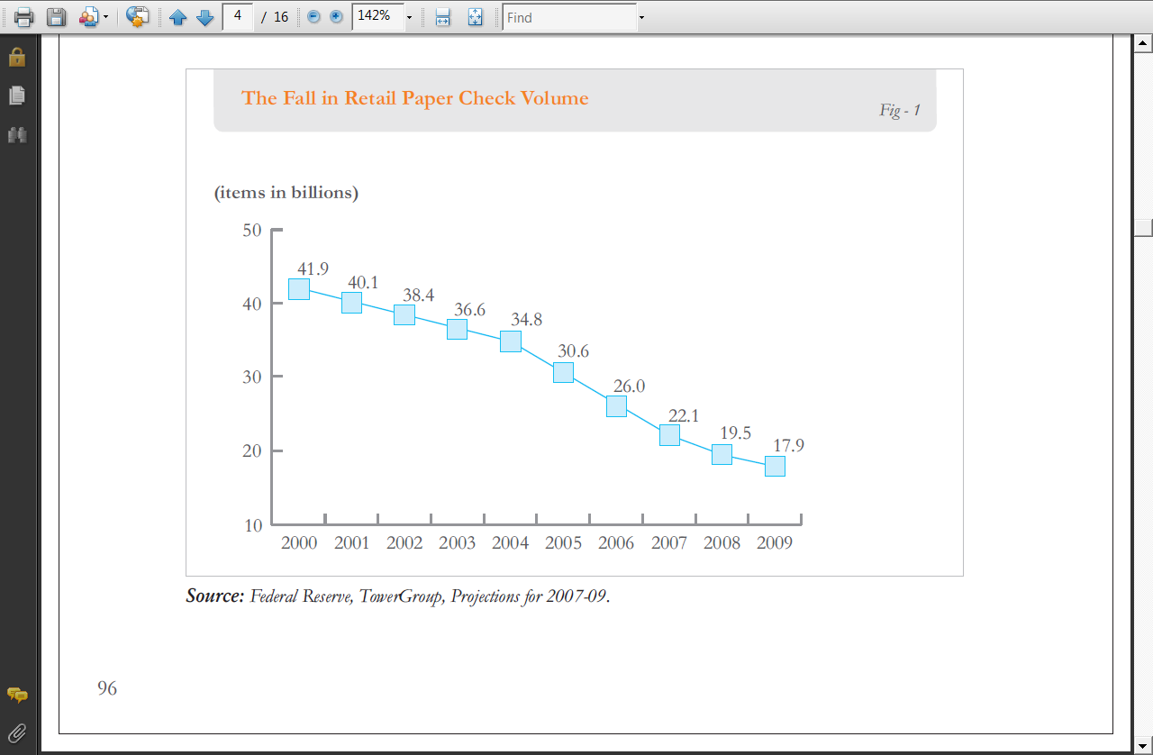
Paper Checks on the Decline
Consumer research completed by FIS™ in 2012 notes that online bill payments and pre-authorized ACH debits account for 49 percent of all recurring bill payment volume while checks comprise only 21 percent.(Source: NACHA Research Brief, October 2012.)

Slide 11
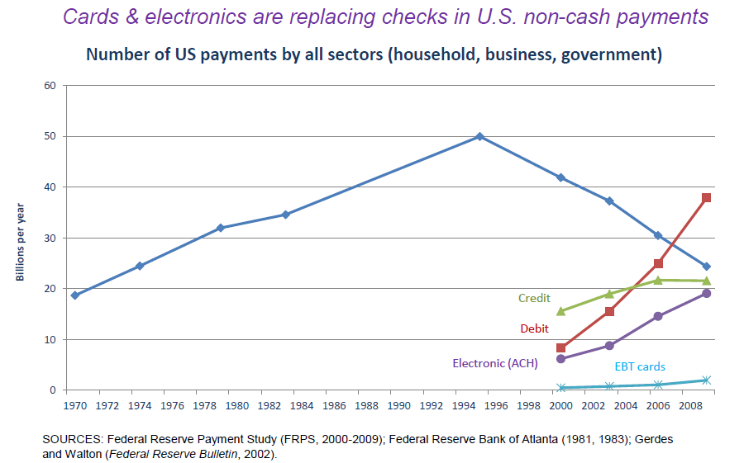
Rise in e-Payments
There were more than 21 billion ACH payments in 2012—a 4.19 percent increase over 2011. (Source: NACHA press release, "ACH Payment Volume Exceeds 21 Billion in 2012," April 7, 2013.)

Slide 12
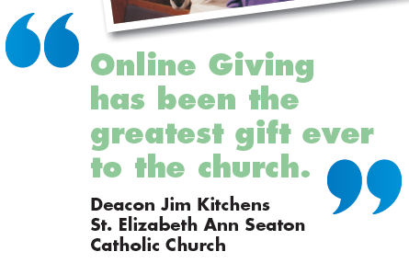
OSV Online Giving Figures
As of 11/1/2013
Number of churches
814
Total number of givers
76,652
Total dollar volume
$126,649,656

Slide 13
Online Giving Overview
Demo
Marketing Online Giving
Online Giving Statistics

Slide 14

Create the Plan
Assign a Champion
Consistent message
Choose your launch time
  Capital Campaign
  Stewardship Renewal
  Offertory Enhancement
Conversion plan off another program
Adjust the plan as necessary
  Plan for Success!

Slide 15

Establish Communication Methods
Lay witness talks
After mass workshops
Establish computer lab
Raffle giveaways
Wine & cheese parties
Coffee & donuts social
  Power Point Presentations
  Scheduled webinars for parishioners
Make it fun!

Slide 16

Recognize Timelines
Develop Online Giving (6 weeks)
  Set up funds
  Create payment settings
Finalize promotional plans (4 weeks)
  Coordinate any event
  Approve materials
  Finalize announcement letter
Internal users (3 weeks)
Launch weekend

Slide 17
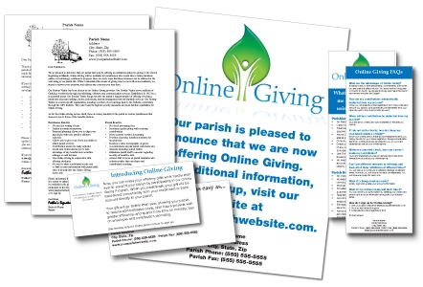
Streamlined Promotional Materials

Slide 18
Enrollment Promotions
Welcome letter from the parish (English and Spanish)
Online Giving FAQ Pamphlet (English and Spanish)
Inserts to go with periodic envelope mailings
Follow up letters from the parish
Posters for display in parish
Material for parish web site
Pew card for Online Givers to drop in offering basket
Free webinars for parish staff on Online Giving

Slide 19

Stewardship of Treasure
Online Giving as a spiritual act
  Part of total decision about stewardship
  Builds faithful stewards
  First fruits giving
  Envelope usage may continue

Slide 20
Online Giving Overview
Demo
Marketing Online Giving
Online Giving Statistics

